Slide 1
Statistical problems - data collection
Numerical summaries of data

Slide 2
how to use Oak lessons

Slide 3
I can choose what data needs to be collected to explore statistical problems.

Slide 4
In a data investigation, the population is the entire set of people, creatures, plants or items that make up the whole group which is being studied.
A sample is a subset of the population.
Bias can be present in any sample collected from a population and may affect the results of a statistical investigation. e.g. only asking year 7 pupils what food should be served in the school canteen.
e.g. only asking people with mobile phones who their provider is.

Slide 5

Statistical problems - data collection
Choosing what data to collect
Choosing where to collect the data from

Slide 6

Choosing what data to collect
Working with data usually starts with having a question we want to investigate.
Planning the statistical enquiry and asking a question
Outcomes and actions
Collection of data
data cycle
Organisation and presentation of data
Interpretation of the data
Analysis of the data

Slide 7
Choosing what data to collect
The question that we are investigating affects what data should be collected and how it should be collected.
Planning the statistical enquiry and asking a question
Outcomes and actions
Collection of data
data cycle
Organisation and presentation of data
Interpretation of the data
Analysis of the data

Slide 8
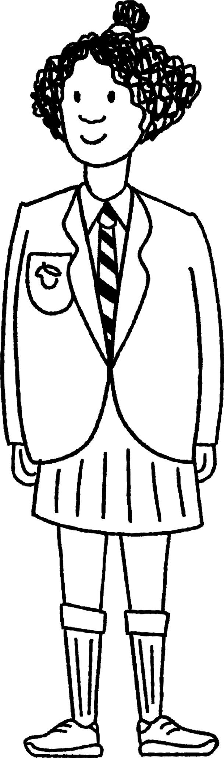


Choosing what data to collect
There are different types of data that could be collected.
Some data are integers:
ages
scores in a sports competition

Slide 9
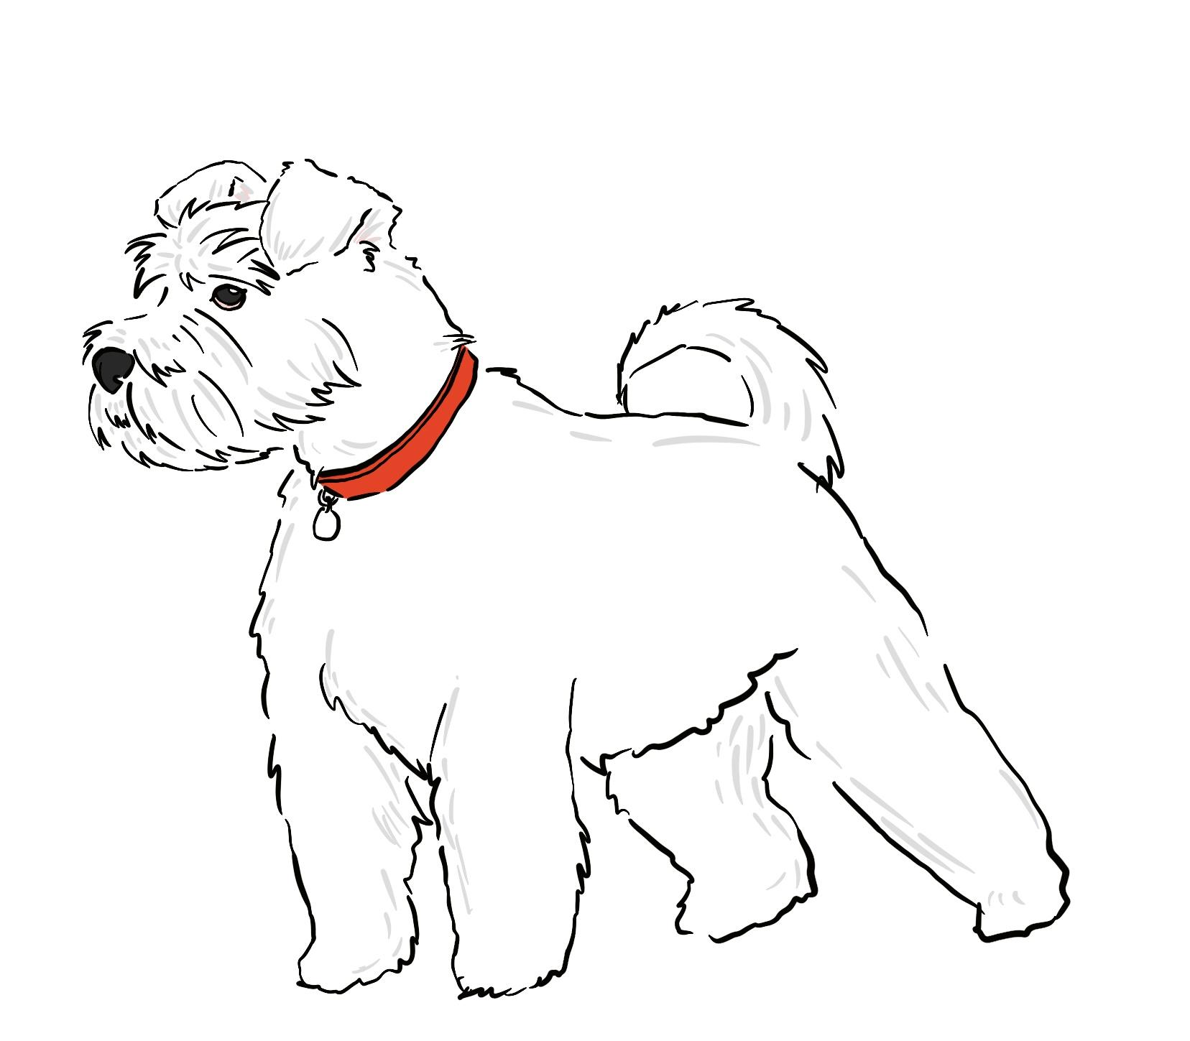
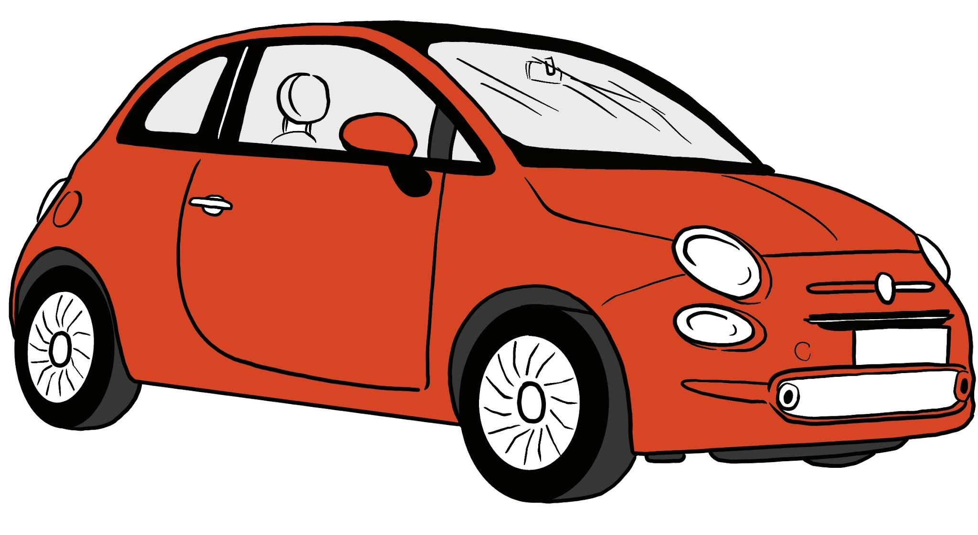
Choosing what data to collect
There are different types of data that could be collected.
Some data can be decimals:
distance travelled
weights of animals

Slide 10


Choosing what data to collect
There are different types of data that could be collected.
Some data are frequencies:
number people who travel by bus
how many workplace accidents occur in a year

Slide 11
Choosing what data to collect
Data can be collected using lots of different methods and tools.
Examples:
questionnaires
interviews
tallying
weighing scales
stop watch
ruler
The methods we may use to collect data depend on what data we want to collect.

Slide 12
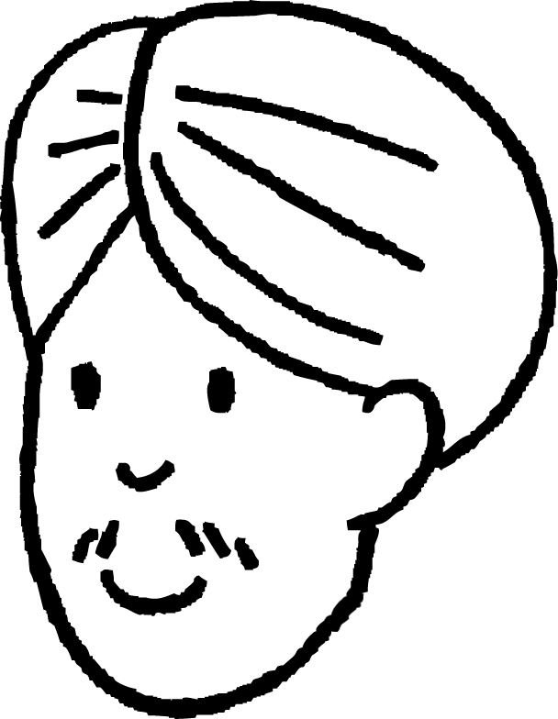
Choosing what data to collect
Andeep wants to know whether the modes of transport used to travel to school differ between younger and older pupils.
What data would be most helpful to investigate this?
frequencies for different modes of transport (e.g. bus, walk, car)
How could Andeep collect the data?
Ask pupils how they get to school and use a tally.
Send a written questionnaire to pupils in his school.

Slide 13

Choosing what data to collect
Laura wants to know whether people who are fast runners are also good at long jump.
What data would be most helpful to investigate this?
race times (seconds) and long jump distances (metres)
How could Laura collect the data?
Time how quickly people finish a 100 metre race using a stopwatch and measure their long jump distances using measuring tape.

Slide 14

Choosing what data to collect
Which tool would be most helpful to collect data about the length of leaves?
stop watch
ruler
weighing scales
questionnaire

Slide 15
Choosing what data to collect
Which tool would be most helpful to collect data how many people take each mode of transport to travel to work?
stop watch
ruler
weighing scales
questionnaire

Slide 16

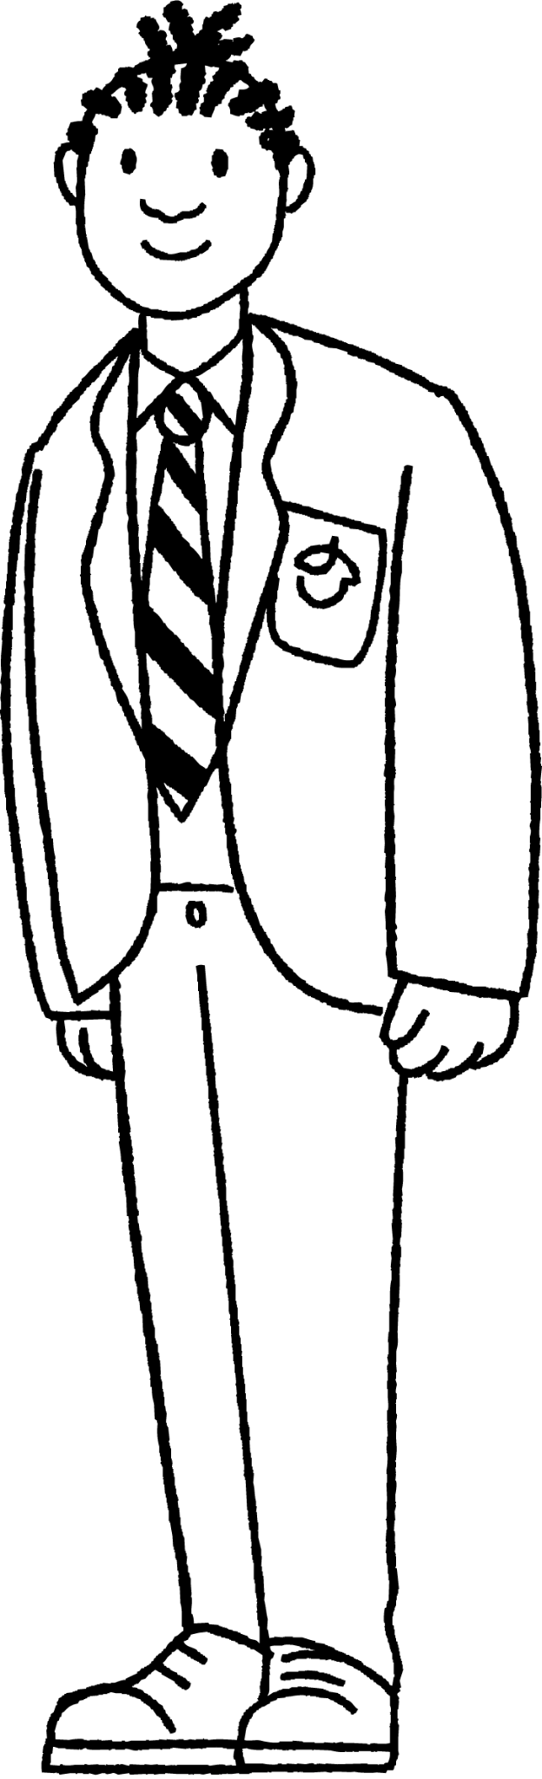
Choosing what data to collect
Jacob has designed a puzzle and wants to know the average time that people take to solve his puzzle.
Which method would be most useful for collecting his data?
a
sending out a questionnaire about his puzzle
b
timing people doing his puzzle
c
interviewing people about his puzzle

Slide 17
Choosing what data to collect
Sometimes we may need to collect data for ourselves.
Sometimes the data we want may have already been collected by somebody else.
In some cases, it can be quicker or easier to use data that is already available rather than collecting data for ourselves.
Example: Laura wants to know whether people who are fast runners are also good at long jump. Where might this data be available?
P.E. teachers may have records.
Data from professional sports competitions may be available online.

Slide 18
Choosing what data to collect
Sometimes it can be impractical or impossible to collect the data we want for ourselves and we have to use data collected by others.
For example, it would be difficult for a school-aged pupil to collect data about the weather in the Antarctic. But there may be scientists who have already collected and shared data about that.
Many large sets of data can be found on the internet (e.g. gov.uk, the Office for National Statistics).

Slide 19

Choosing what data to collect
Sam wants to investigate whether there is a correlation between the number of houses in a city and the number of public parks.
They decide to collect the following data for 20 cities:
number of houses per city
number of parks per city
Explain why Sam may not be able to collect this data themselves.
It could be difficult to count all the houses and parks in each city.
What could Sam do instead?
See if the data is already available online or at the councils for each city.

Slide 20
Choosing what data to collect
You always have to collect new data for a statistical investigation.
People are only allowed to analyse data that they have collected themselves.
Sometimes the data you want to analyse has already been collected and made available to you.

Slide 21
Choosing what data to collect
1) A supermarket manager collects data to investigate ways to save money, increase sales and improve the customers’ experience.
Match the data with the most appropriate tools for collecting it.
customers’ opinions about a product that is for sale
questionnaire
number of customers visiting at each time of the day
stopwatch
weight of the vegetables which are left unpurchased
tally chart
time that customers spend queuing at the checkout
weighing scales

Slide 22
Choosing what data to collect
1) A supermarket manager collects data to investigate ways to save money, increase sales and improve the customers’ experience.
Match the data with the most appropriate tools for collecting it.
customers’ opinions about a product that is for sale
questionnaire
number of customers visiting at each time of the day
stopwatch
weight of the vegetables which are left unpurchased
tally chart
time that customers spend queuing at the checkout
weighing scales

Slide 23
Statistical problems - data collection
Choosing what data to collect
Choosing where to collect the data from

Slide 24
Choosing where to collect the data from
When collecting data, we should consider what population the investigation is about.
In a data investigation, the population is the entire set of people, creatures, plants or items that make up the whole group which is being studied.
Examples:
population
all people in a region
all fish in a lake
all trees on an island
all subscribers to an online product

Slide 25
Choosing where to collect the data from
The population is not necessarily everyone in a particular place. It is defined by what the investigation intends to study.
Example: in an investigation about how much time school children spend doing homework, the population is defined by the research question.
research question | population
How much time do 16 year-old pupils in the UK spend doing homework per week?
All 16 year old pupils in the UK (tens of thousands)
How much time do pupils from my school spend doing homework per week?
All pupils in the school (thousands)
How much time do 16 year old pupils from my school spend doing homework per week?
All 16 year old pupils in the school (hundreds)

Slide 26
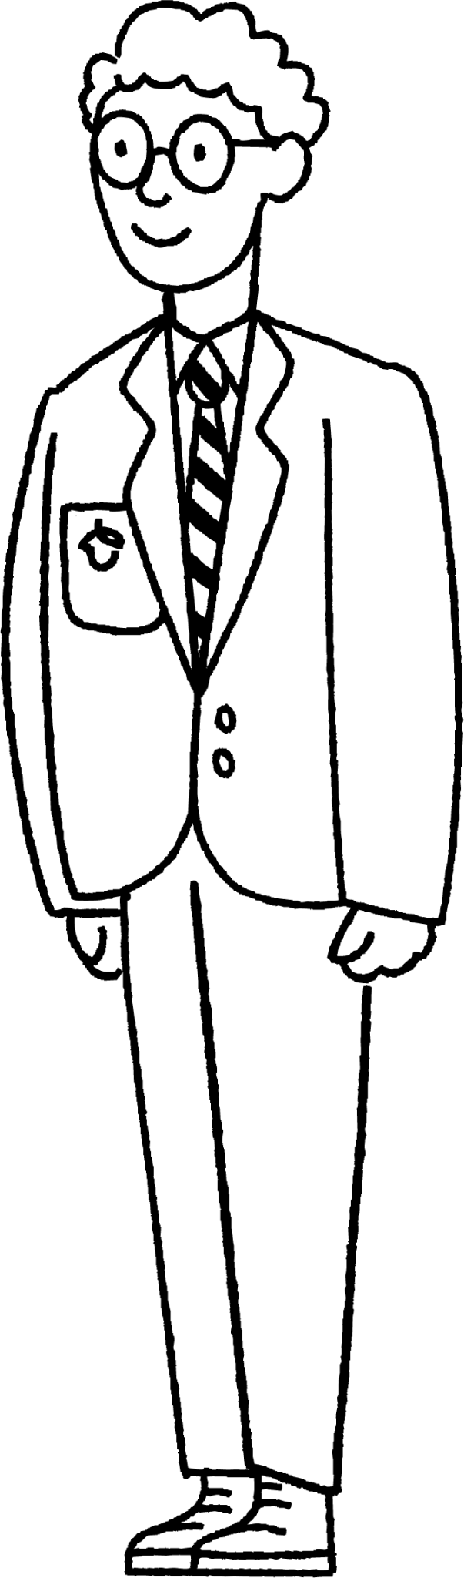
Choosing where to collect the data from
Alex wants to investigate how much time pupils in his school spend doing homework per week. The population of Alex’s investigation includes all the pupils in his school.
Alex considers collecting data by asking every pupil in the school how much time they spend doing homework per week.
What problems could Alex have if he tried to do this?
It could be difficult to speak to everyone in the school.
It could be time consuming to ask everyone in the school.
It could be time consuming to organise the data after it has been collected.

Slide 27
Choosing where to collect the data from
Sometimes it is impractical to collect data from the entire population.
In these cases, data might be collected from a smaller subset of the population instead.
A subset of the population is called a sample.
population
sample

Slide 28
Choosing where to collect the data from
When we use data from a sample, we make an assumption that the results would have been similar if we had collected data from the whole population.
population data summaries
sample data summaries
population
sample

Slide 29

Choosing where to collect the data from
The larger the sample, the more difficult it can be to collect the data. However if a sample is too small it might then not provide enough data to make a reliable conclusion.
The size of your sample may depend on what data you are collecting and what methods you are using to collect it.
Examples:
Interviewing people for detailed opinions about something can take a lot of time so you may want to use a small sample.
An electronic questionnaire asking people to rate something can be much quicker, so you may use a large sample.

Slide 30
Choosing where to collect the data from
Alex wants to investigate how much time pupils in his school spend doing homework per week. The population of Alex’s investigation includes all the pupils in his school.
Alex decides to collect data from a sample of 20 pupils.
He chooses 20 pupils from the youngest year group for his sample.
What problems could there be with his choice of sample?
All the pupils are in the same year group.
Older pupils may get more homework than younger pupils.
The sample does not accurately represent the population.
Propose a different way that Alex could choose his sample of pupils.
Choose four pupils from each year group.

Slide 31
Choosing where to collect the data from
Bias can be present in any sample collected from a population and may affect the results of a statistical investigation.
Bias can be caused by collecting data from a sample that is not representative of the population.
population data summaries
sample data summaries
whole school
group of pupils from youngest year group

Slide 32
Choosing where to collect the data from
Izzy wants to investigate which genres of books pupils in her school enjoy reading. She chooses a class in the oldest year group and gives them a questionnaire about which books they read.
What is the population in Izzy’s investigation?
a
all the school pupils in the country
b
all the pupils in Izzy’s school
c
all the pupils in the oldest year group of Izzy’s school
d
all the pupils in the class that were given the questionnaire

Slide 33
Choosing where to collect the data from
Izzy wants to investigate which genres of books pupils in her school enjoy reading. She chooses a class in the oldest year group and gives them a questionnaire about which books they read.
What is the sample in Izzy’s investigation?
a
all the school pupils in the country
b
all the pupils in Izzy’s school
c
all the pupils in the oldest year group of Izzy’s school
d
all the pupils in the class that were given the questionnaire

Slide 34
Choosing where to collect the data from
Izzy wants to investigate which genres of books pupils in her school enjoy reading. She chooses a class in the oldest year group and gives them a questionnaire about which books they read.
Why might Izzy’s results be biased?
All the pupils in the sample are the same age.
The genres of books people enjoy may differ with age.
The opinions of the sample may not represent the opinion of the population.

Slide 35
Choosing where to collect the data from
1) Jun wants to find out the average time people take to run a 100 metre race in his school. He assists in a PE lesson for a class in the youngest year group by timing how long each pupil takes to complete the race. He then calculates the mean time. a) What is the population in Jun’s investigation?
b) Who does Jun use in his sample?
c) Why could Jun’s data be biased?
d) Propose an alternative way for Jun to collect his data.

Slide 36
Choosing where to collect the data from
2) Laura wants to investigate how much time adults in the UK spend exercising, per week. She designs a questionnaire about people’s exercise habits. She goes to her local gym and asks people to complete her questionnaire. a) What is the population in Laura’s investigation?
b) Who does Laura use in her sample?
c) Why could Laura’s data be biased?
d) Propose an alternative way for Laura to collect data using her questionnaire.

Slide 37
Choosing where to collect the data from
1) Jun wants to find out the average time people take to run a 100 metre race in his school. He assists in a PE lesson for a class in the youngest year group by timing how long each pupil takes to complete the race. He then calculates the mean time. a) What is the population in Jun’s investigation?
b) Who does Jun use in his sample?
all the pupils in Jun’s school
a class in the youngest year group

Slide 38
Choosing where to collect the data from
c) Why could Jun’s data be biased?
d) Propose an alternative way for Jun to collect his data.
He has only collected data from a single age group.
Older pupils might run faster than younger pupils.
The average time for the sample could be much higher than the average time for the whole school (assuming older students run faster).
Use a sample that includes a mixture of people from each year group.
The PE teachers may already have data for the whole school.

Slide 39
Choosing where to collect the data from
2) Laura wants to investigate how much time adults in the UK spend exercising, per week. She designs a questionnaire about people’s exercise habits. She goes to her local gym and asks people to complete her questionnaire. a) What is the population in Laura’s investigation?
b) Who does Laura use in her sample?
all adults in the UK
people who attend the gym that she went to who agree to take her questionnaire

Slide 40
Choosing where to collect the data from
c) Why could Laura’s data be biased?
d) Propose an alternative way for Izzy to collect data using her questionnaire.
She has only collected data from people who are members of a gym.
People who go to a gym may do more exercise than people who don’t.
Her results might suggest that adults in the UK spend more time doing exercise than they actually do.
Conduct her questionnaire in a place where both gym members and non-gym members might go to (e.g. town high street or supermarket)

Slide 41
Statistical problems - data collection
Different statistical problems need to be investigated in different ways.
When it is impractical to collect data from an entire population, data may be collected from a sample.
When sampling from a population, the sample size needs to be practical.
Be aware of any factors of a data investigation that may cause bias and attempt to reduce it where appropriate.

Slide 42

© Oak National Academy 2023.
Produced in partnership with Mathematics in Education and Industry.
Licensed on the Open Government Licence v3.0, except where otherwise stated. See Oak terms and conditions.

